Slide 1
Shoes On Containers
Presented by
Alain El Khoury
Melody Abi Khalil
Saint Joseph University, Faculty of Engineering

Slide 2
Outline
Introduction
Microservices
Docker
RabbitMQ
Project implementation
Run project
Results
References

Slide 3
Introduction

Slide 4
Introduction
Shoe E-Commerce website
3 microservices:
Catalog microservice
Ordering microservice
Basket microservice
API Gateway
Notes:
The application is a shoe E-Commerce website (like Amazon) that is implemented as a multi-container application. Each container is a microservice developed using .NET Core.
The application consists of 3 microservices:
1. Catalog microservice
2. Ordering microservice
3. Basket microservice
Also, there is an API gateway as an entry point to the internal microservices.

Slide 5
Microservices

Slide 6
Microservices
Building single-function modules
Independently developed, tested, deployed, monitored, scaled
Notes:
A microservice is a method of developing software systems to focus on building single-function modules.
Using microservices has several benefits and advantages.
It is highly maintainable and testable as we only have to test the functionalities in this microservice and not several fields and features.
A microservice is independently deployable, using containers for example. It makes each microservice an autonomous unit.
Also, a microservice is monitored easily because it has a reduced number of code lines compared to a monolithic application.

Slide 7
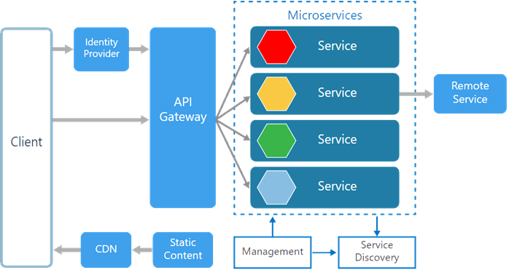
Microservices
Notes:
There are various components in a microservices architecture apart from microservices themselves:
-Management. Maintains the nodes for the service.
-Identity Provider. Manages the identity information and provides authentication services within a distributed network.
-Service Discovery. Keeps track of services and service addresses and endpoints.
-API Gateway. Serves as client’s entry point. Single point of contact from the client which in turn returns responses from underlying microservices and sometimes an aggregated response from multiple underlying microservices.
-CDN. A content delivery network to serve static resources for e.g. pages and web content in a distributed network
-Static Content The static resources like pages and web content
Microservices are deployed independently with their own database per service so the underlying microservices look as shown in the following picture.

Slide 8
.NET Core
Free and open-source, managed computer software framework
Supports C#, F# and VB
Notes:
.NET Core is a free and open-source, managed computer software framework for Windows, Linux, and macOS operating systems. It is an open source, cross platform successor to .NET Framework.
.NET Core fully supports C# and F# and partially supports Visual Basic .NET.

Slide 9
C#
General-purpose, multi-paradigm programming language
Developed as part of .NET initiative
Notes:
In our project, we used C#
It is a general-purpose, multi-paradigm programming language
It was developed around 2000 by Microsoft as part of its .NET initiative

Slide 10
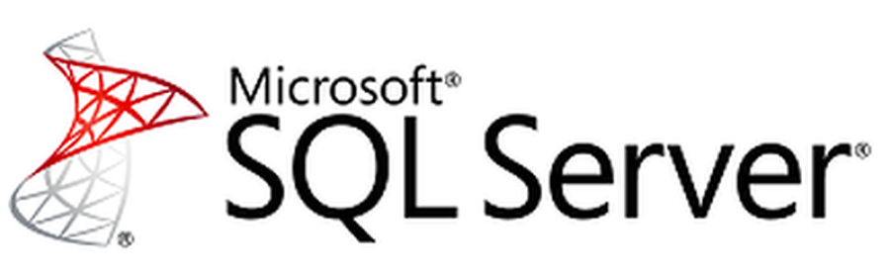
MS SQL Server
Relational Database Management System by Microsoft
GUI and command based software
Notes:
Microsoft SQL Server is a relational database management system developed by Microsoft. As a database server, it is a software product with the primary function of storing and retrieving data as requested by other software applications.
It is both GUI and command based software.
SQL Server can be used to create and maintain databases as well as analyze data through several SQL Server tools.

Slide 11
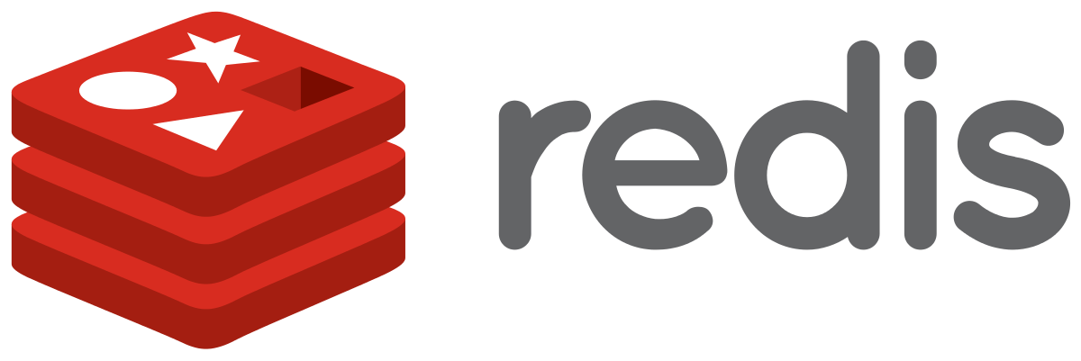
Redis
Open source, in-memory data structure store
Used as database, cache and message broker
Notes:
Redis is an open source (BSD licensed), in-memory data structure store, used as a database, cache and message broker. It supports many data structures (strings, hashes, lists, sets,…)

Slide 12
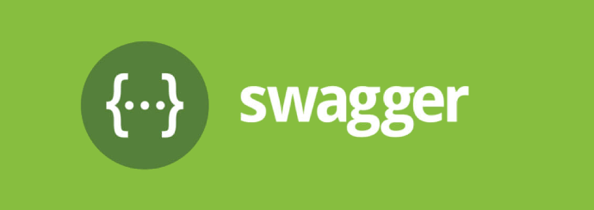
Swagger
Open-source software framework for design, documentation & consumption of REST APIs
Allows to visualize and interact with the API’s resources
Automatically generated from the OpenAPI Specification
Human Friendly
Dependency Free
All browser support
Notes:
Swagger is an open-source software framework backed by a large ecosystem of tools that helps developers design, build, document, and consume RESTful web services. While most users identify Swagger by the Swagger UI tool, the Swagger toolset includes support for automated documentation, code generation, and test-case generation.
Here are some advantages of Swagger:
-Dependency Free: The UI works in any development environment, be it locally or in the web
-Human Friendly: Allow end developers to effortlessly interact and try out every single operation your API exposes for easy consumption
-All Browser Support: Cater to every possible scenario with Swagger UI working in all major browsers

Slide 13
Docker

Slide 14
Docker
Open-source project for automating the deployment of applications
Create, Deploy & Run application by using containers
Notes:
Docker is an open-source project for automating the deployment of applications as portable, self-sufficient containers that can run on the cloud or on-premises
Docker is a tool designed to make it easier to create, deploy, and run applications by using containers. Containers allow a developer to package up an application with all of the parts it needs, such as libraries and other dependencies, and ship it all out as one package.

Slide 15
Containerization
Software approach in which the application, its dependencies and configuration are packaged as a container image
Containers = isolated applications
Isolation, portability, agility and scalability
Notes:
Containerization is an approach to software development in which an application or service, its dependencies, and its configuration are packaged together as a container image. The containerized application can be tested as a unit and deployed as a container image instance to the host operating system.
The containers are considered as isolated applications, because of their independence.
Containerization has several benefits including isolation, portability, agility and scalability.

Slide 16
Fundamental Docker concepts
Notes:
Docker has several fundamental concepts:
Docker Client
The Docker Client is what the end-user of Docker communicates with. It is like the UI for Docker. The developer communicates with the Docker Client, which then communicates the instructions to the Docker Daemon.
Docker Daemon
The Docker daemon is what actually executes commands sent to the Docker Client — like building, running, and distributing your containers. The Docker Daemon runs on the host machine, but as a user, you never communicate directly with the Daemon.
Dockerfile
A Dockerfile is where the instructions are written to build a Docker image.
Docker Image
Images are read-only templates that you build from a set of instructions written in the Dockerfile.
The Docker image is built using a Dockerfile. Each instruction in the Dockerfile adds a new “layer” to the image, with layers representing a portion of the images file system that either adds to or replaces the layer below it.
Volumes
Volumes are the “data” part of a container, initialized when a container is created. Volumes allow to persist and share a container’s data. Even if we destroy, update, or rebuild a container, the data volumes will remain untouched.
Docker Containers
A Docker container wraps an application’s software into an invisible box with everything the application needs to run. That includes the operating system, application code, runtime, system tools, system libraries, and etc. Docker containers are built off Docker images.

Slide 17
HumanTech website
RabbitMQ

Slide 18
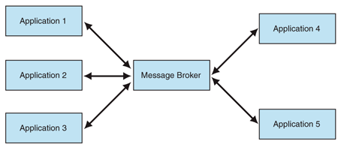
Message Broker
Program that translates a sender format message to a receiver format message
Notes:
A message broker is “a program that translates a message to a formal messaging protocol of the sender, to the formal messaging protocol of the receiver”.
The primary purpose of a broker is to take incoming messages from applications and perform some action on them.

Slide 19
RabbitMQ
Open-source message-broker software
Way to exchange data between different platform applications
Supports multiple OS and Programming Languages
Notes:
RabbitMQ is an open-source message-broker software.
RabbitMQ is also a way to exchange the data between different platform applications such as a message sent from .Net application can be read by a Node.js application or Java application.
It also supports multiple operating systems and programming languages.

Slide 20
Project Implementation

Slide 21
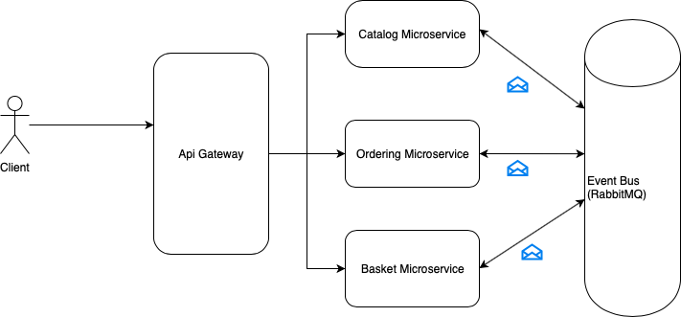
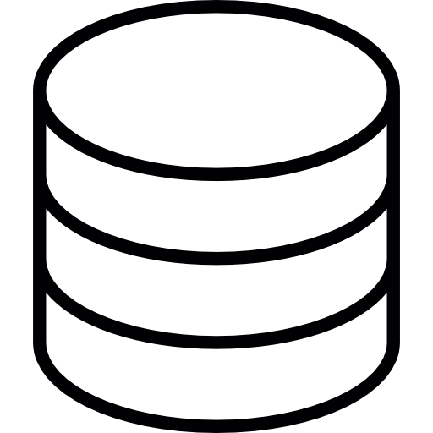
Overview
SQL
HTTP
SQL
Redis
Notes:
The project is a microservice oriented architecture and each microservice has its own database.
SQL database for catalog and ordering microservices and Redis database for Basket microservice
HTTP is the communication protocol between the client and microservices, and asynchronous message based communication between microservices. Message queues are handled with RabbitMQ.
The architecture also includes also an API Gateway

Slide 22
Basket Microservice
Add products to basket
Redis database
Routes
GET /api/basket/{id}
DELETE /api/basket/{id}
POST /api/basket
Notes:
Basket microservice is used to give the user the ability to add products that he might purchase while shopping.
This microservice saves data inside a Redis database rather than a session storage, we chose Redis because we don’t want to store these data permanently, we just want to store them for a period of time and when the user order these products, we want to delete them immediately.
Redis will be running inside a Docker container
This microservice offers 3 routes:
GET /api/basket/{id} to get a basket by id, this id will be the customer id
DELETE /api/basket/{id} to delete a basket by id
POST /api/basket to create or add items to a basket

Slide 23
Basket Microservice Implementation
Singleton service
Adding cross-origin resource sharing service
Model creation
Redis configuration
Creation of APIs
Notes:
First, we need to add a singleton service that represents an inter-related group of connections to Redis servers.
We then add cross-origin resource sharing service.
Once done, we create our data models. In this microservice, we have the Basket & BasketItem models.
A simple Redis configuration is then needed to link to the database.
Finally, we create the different APIs we mentioned in the previous slide.

Slide 24
Catalog Microservice
Get products of shop
Routes
CRUD operations on items
Notes:
Using this microservice, you can get all items of this online shop. The job of this microservice is to CREATE, READ, UPDATE or DELETE (CRUD operations) items with the help of its own SQL database. This microservice can also responds with paginated items list.

Slide 25
Ordering Microservice
Add order when completed
Routes
GET /api/basket/{id}
DELETE /api/basket/{id}
POST /api/basket
Notes:
This microservice is responsible of keeping the orders data in a SQL database, when the order is completed, we will publish a message to the RabbitMQ channel and the basket microservice will catch this message and will delete all the products inside the basket
This microservice has 3 routes:
POST /api/orders/new to create a new order
GET /api/orders/ to get all orders
GET /api/orders/{id} to get an order by id

Slide 26
Catalog & Ordering Implementation
Creation of entities
Creation of context class
Registration of context
Database migrations
Adding cross-origin resource sharing service
Creation of APIs
Messaging
Notes:
An entity in Entity Framework is a class that maps to a database table. We need to store two things, an order and an orderItem.
Then we create the context class which represents a session with underlying database using which we perform the CRUD operations.
Then we need to register this context as a service.
At this point, we performed the database migration. The migrations feature in Entity Framework provides a way to incrementally update the database schema to keep it in sync with the
application's data model while preserving existing data in the database.
We also add cross-origin resource sharing service for these microservices, and create the different APIs needed.
Finally, for ordering microservice, once a user orders some products, we need to clear their basket. In order to do that, the ordering microservice will send a message to the basket microservice using RabbitMQ.

Slide 27
Dockerization of microservices
7 docker images inside Docker compose file:
Catalog
Basket
Mssqlserver
Redis
Ordering
Gateway
Rabbitmq
Notes:
Each microservice in ShoesOnContainers is dockerized.
These microservices need to communicate with each other so they need to be in the same Docker network.
In ShoesOnContainers, we have 7 services that need to be inside a Docker container

Slide 28
Dockerization steps
Specify image name
Define configuration options that are applied at build time
Define environment variables
Specify container name
Specify external and internal port of Docker container
Specify network
Specify which container should be available before running service
Notes:
To add a docker image inside docker compose file we need to do the following steps

Slide 29
API Gateway

Slide 30
API Gateway
Why?
Simplify usage of microservices
How?
Ocelot: open-source .NET Core API Gateway
Add ocelot.json to give Ocelot direction for microservice redirects
Add Ocelot plumbing
Notes:
We don’t need an API gateway, but using a Gateway pattern sure simplifies things.
In a Microservices architecture, there’s a couple of different strategies we can follow: -We can either have separate APIs that individual consumers need to be aware of, -Or we can present a unified API via an API Gateway.
If we’re presenting your API via a unified gateway, we will need an API Gateway platform.We developed this API Gateway using Ocelot, an open-source .NET Core API Gateway.
We create a microservice. At this point, we need to do 2 things:
1.Add ocelot.json to give Ocelot directions for microservice redirects 2.Add Ocelot plumbing in the ApiGateway ASP.NET Core Web API Project
To add the configuration, we simply add an ‘ocelot.json’ file.

Slide 31
API Gateway
Configure ocelot.json file
Configure host: localhost:5000
Define redirects
Notes:
There are some important things to note in the ocelot.json file:
The GlobalConfiguration allows us to define the BaseUrl that Ocelot is going to listen to. In our case, we configured it to use localhost:5000
The ReRoutes array allows us to define one or more redirects. The downstream paths represent the paths to the microservices. The upstream paths represent how the users will access these microservices via the API Gateway.

Slide 32
Swagger

Slide 33
Swagger
Add Swashbuckle.AspNetCore package
Add SwaggerUI in Startup.cs
Access swagger using: localhost:5100/swagger
Notes:
If we want to add swagger to a microservice we need to follow these steps

Slide 34
Run the Project

Slide 35
Run the Project
Run each of the following command on different terminal
1. Build docker images
docker-compose build
2. Start MSSQL server
docker-compose up mssqlserver
3. Start Redis
docker-compose up basket.data
4. Start rabbitmq
docker-compose up rabbitmq
5. Start the catalog microservice
docker-compose up catalog
6. Start the ordering microservice
docker-compose up ordering
7. Start the basket microservice
docker-compose up basket
8. Start the api gateway
docker-compose up gateway
Notes:
To start the application, you need first build the images and then run mssql server, redis database and rabbitmq because our microservice depends on them
Then you need to start the microservices

Slide 36
Results

Slide 37
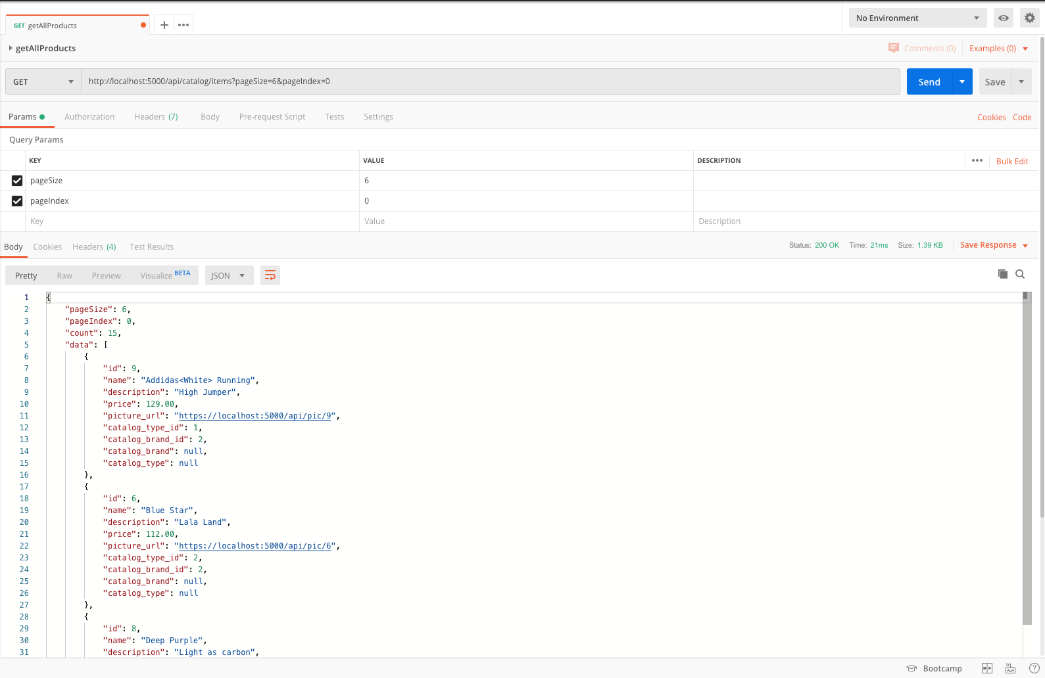
Get Products
To get the first 6 products, send a GET request to the Catalog Microservice through the API Gateway
Notes:
We will do a step by step demo to get some products, choose one and finally order it
First we need to get the first 6 products ( catalog microservice returns paginated responses ), we will call the catalog microservice through the api gateway

Slide 38
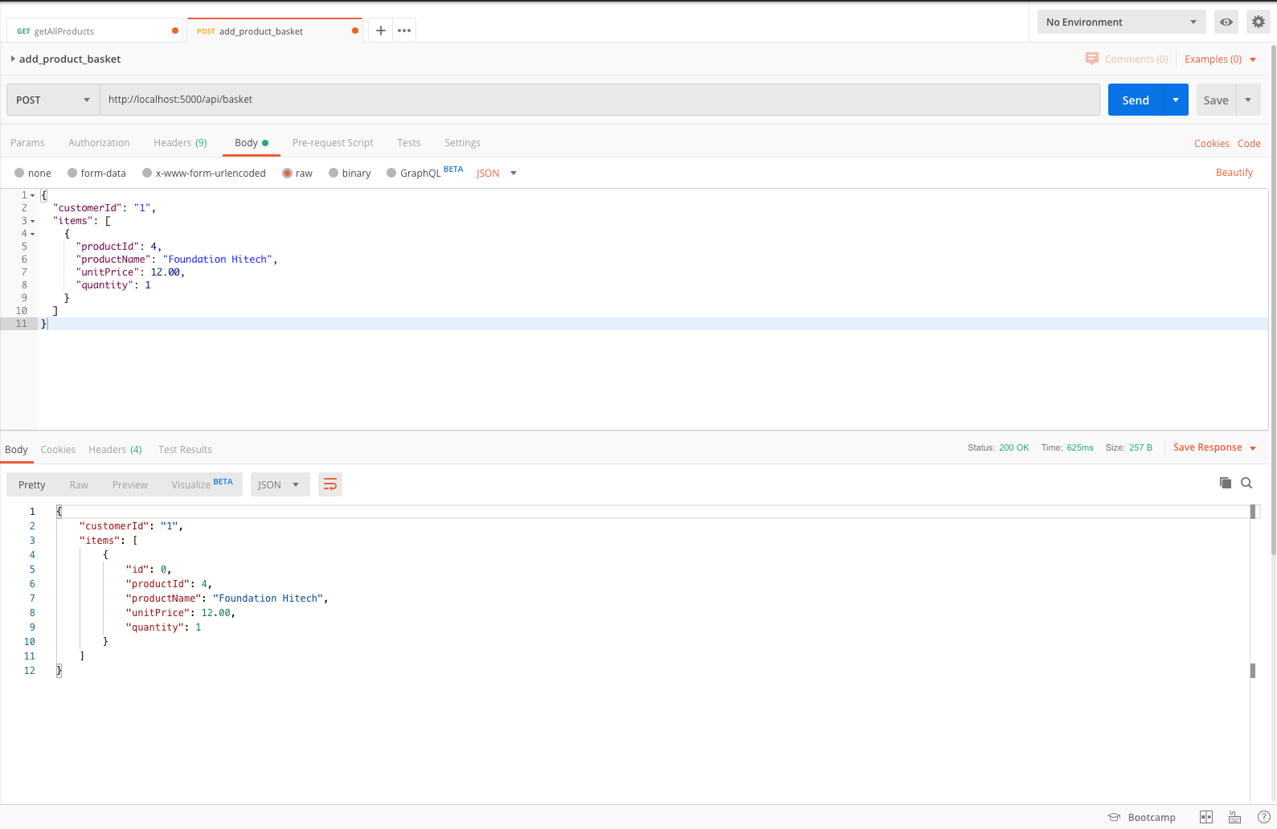
Add a Product to Basket
To add a product to the basket, send a POST request to the Basket Microservice through the API Gateway
Notes:
We will choose a product and then we will add it to the basket
We will do this by a post request to the basket microservice through the api gateway, where we should specify the customer id and the items that we want to add

Slide 39
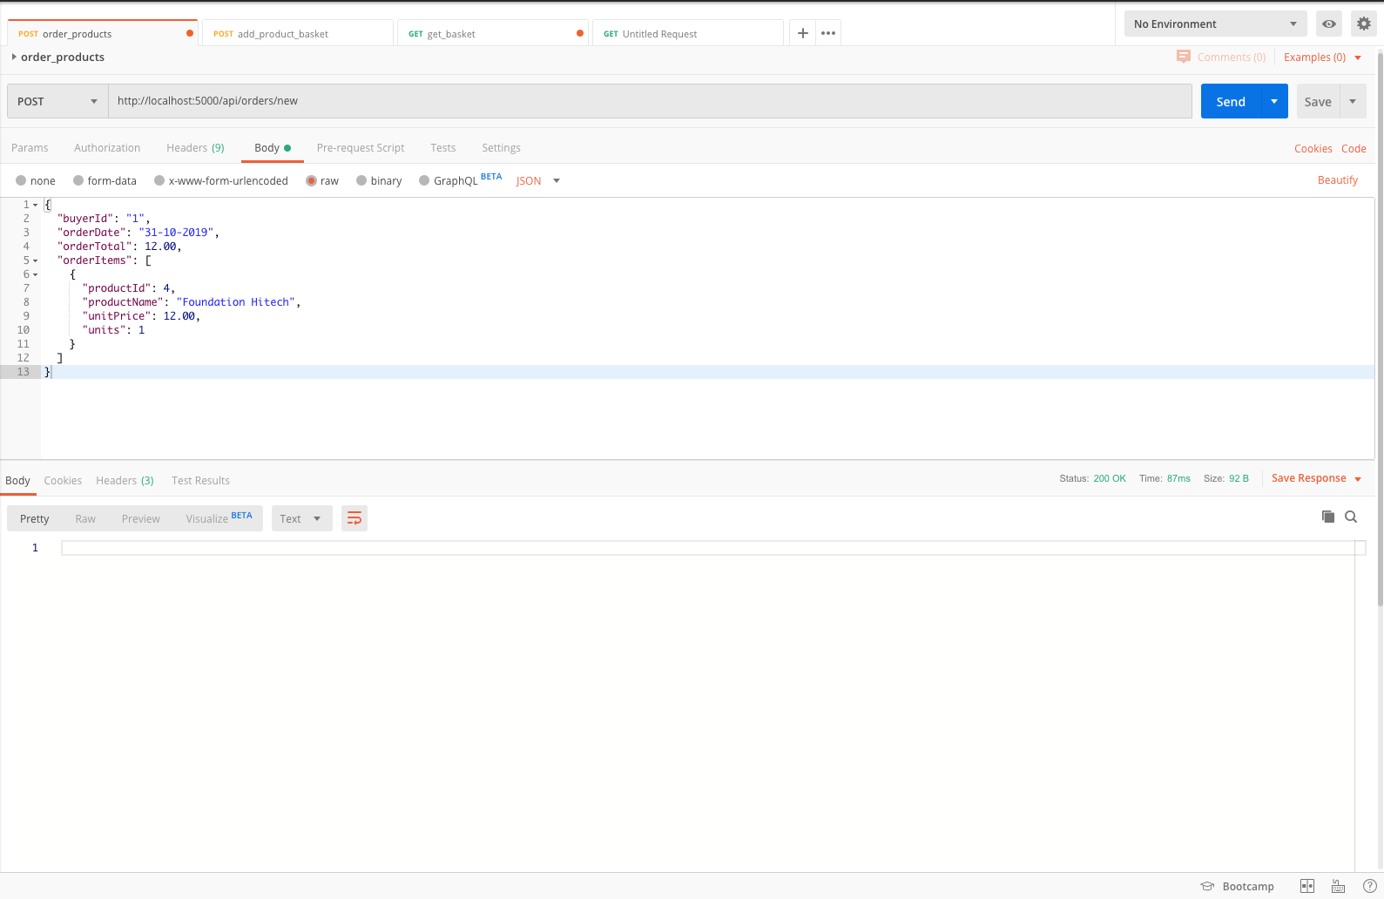
Order Products
To order a product, send a POST request to the Ordering Microservice through the API Gateway
Notes:
Finally to order the products, we just need to send a POST request to the ordering microservice with the buyer id, order date, total amount, and the items that we want to oder

Slide 40
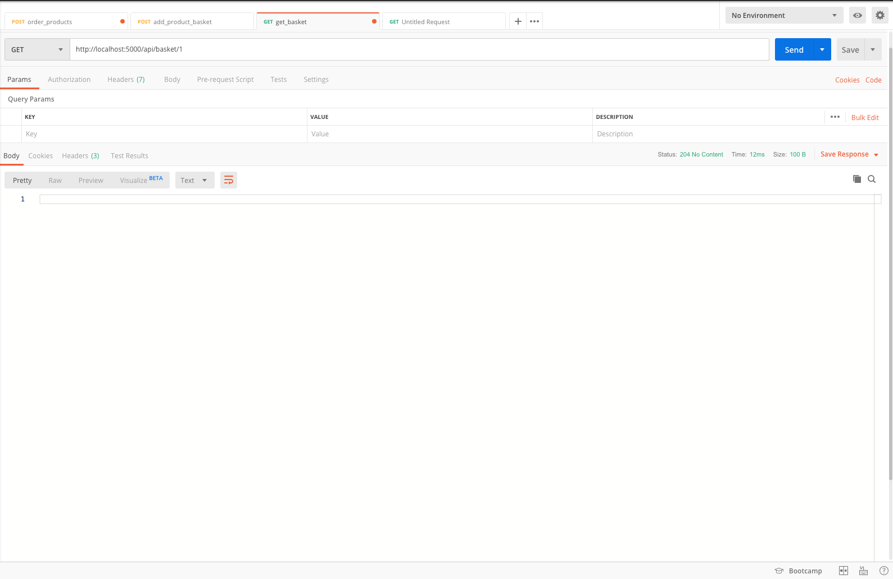
Clearing the Basket
The ordering microservice will publish a message that the customer with customerId = 1 ordered his products, then the basket microservice will catch this message and it will remove all items from his basket.
Notes:
When the order is completed, we will publish a message to the RabbitMQ channel and the basket microservice will catch this message and will delete all the products inside the basket

Slide 41
Conclusion
Notes:
In conclusion, we have managed to build an online shop for shoes using 3 different and completed separated dockerzied microservices developed in .NET.
The user can first look through the products to choose one, and then either order it directly or add it to their basket.

Slide 42
Conclusion
3 different & completely separated microservices:
Dockerized
In .NET
With Swagger UI
RabbitMQ messaging
Notes:
In conclusion, we have managed to build an online shop for shoes using 3 different and completely separated dockerzied microservices developed in .NET, with a Swagger UI and a RabbitMQ messaging.
The user can first look through the products to choose one, and then either order it directly or add it to their basket.

Slide 43
THANK YOU!

Slide 44
References
1. “Why Use Microservices?”, DZone. [Online]. Available: dzone.com. Accessed: 23/9/2019
2. “What is Microservices?”, Smart bear. [Online]. Available: smartbear.com. Accessed: 15/7/19
3. “.NET Microservices: Architecture for Containerized .NET Applications”, Microsof. [Online]. Available: docs.microsoft.com. Accessed: 23/9/19
4. “What is Docker?”, Open Source. [Online]. Available: opensource.com. Accessed: 24/9/2019
5. “C#”, Tutorials Point. [Online]. Available: tutorialspoint.com. Accessed: 24/9/2019
6. “MS SQL Server – Overview”, Tutorials Point. [Online]. Available: tutorialspoint.com. Accessed: 24/9/2019
7. “Introduction to Redis”, Redis. [Online]. Available: redis.io. Accessed: 5/10/2019
8. “An introduction to Message Brokers”, Medium. [Online]. Available: medium.com. Accessed: 5/10/2019
9. “Introduction to RabbitMQ”, Tutlane. [Online]. Available: tutlane.com. Accessed: 5/10/2019
10. “Swagger UI”, Swagger. [Online]. Available: swagger.io. Accessed: 13/10/2019
11. “ASP.NET Core 2.0 E-Commerce website based on microservices”, Udemy. [Online]. Available: udemy.com. Accessed: 25/9/2019

